Slide 1

TREND PATTERNS

Slide 2

Introduction
Trend Lines
Trend Channels
Ascending, Descending and Horizontal Channels
Triangle Patterns
Continuation Patterns

Slide 3
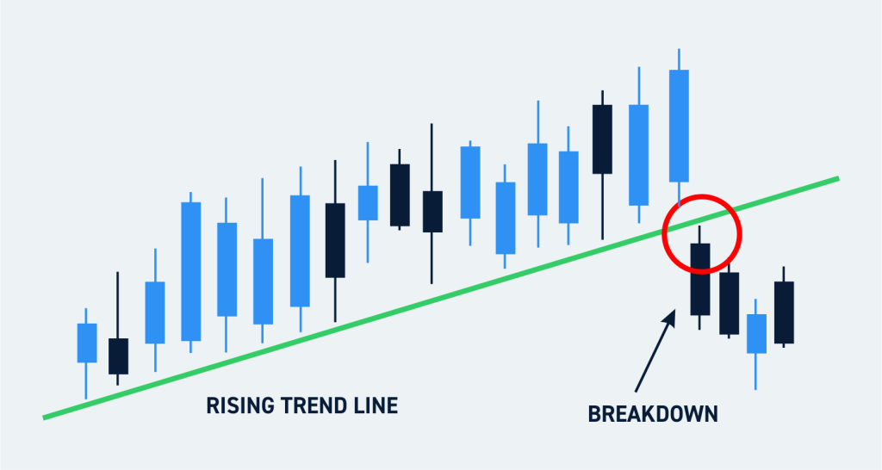
Trend Lines
Discussed in Previous Lecture
Notes:
An imaginary straight line.
Connects two or more price points and extends into future.
Support and Resistance.
Note:
The more points used to draw the trend line, the more valid it will be.

Slide 4
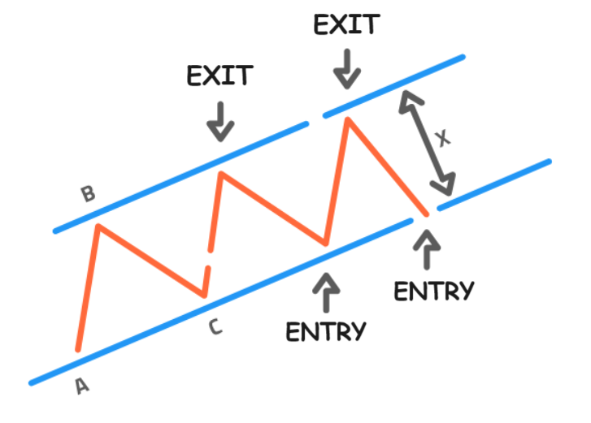
Trend Channels
Asset —> Between two parallel trend lines.
Formed through four contact points.
Two Highs
Two Lows

Slide 5
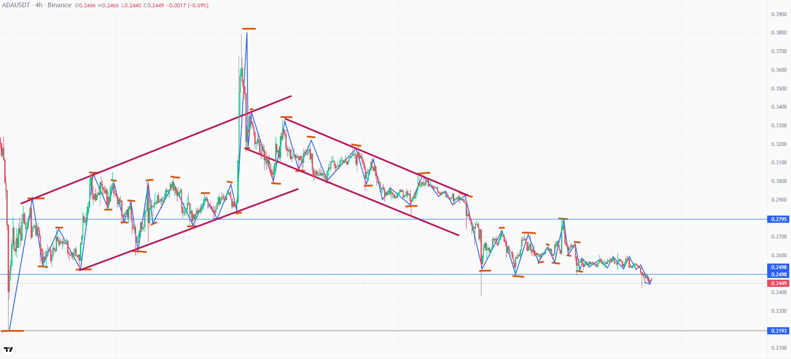
Trend Channels

Slide 6
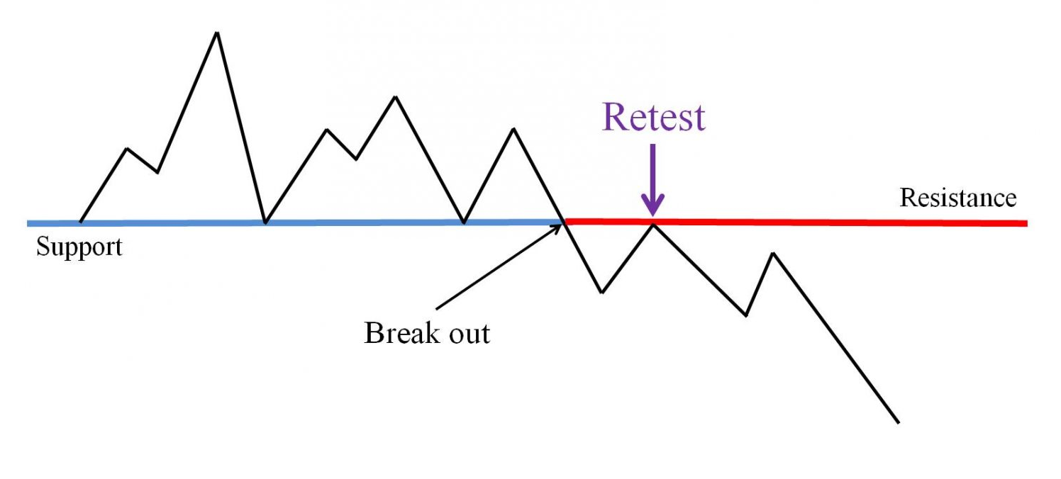
Ascending, Descending and Horizontal Channel
If a price does break out then after break out it comes back for retesting once.
If re-testing is successful then you can proceed with the next breakout pattern.

Slide 7
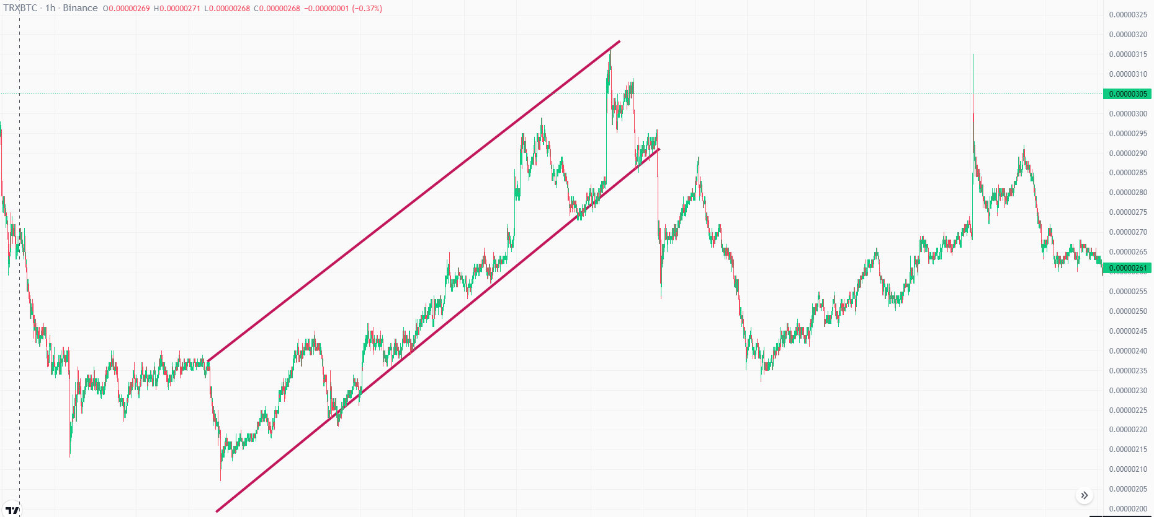
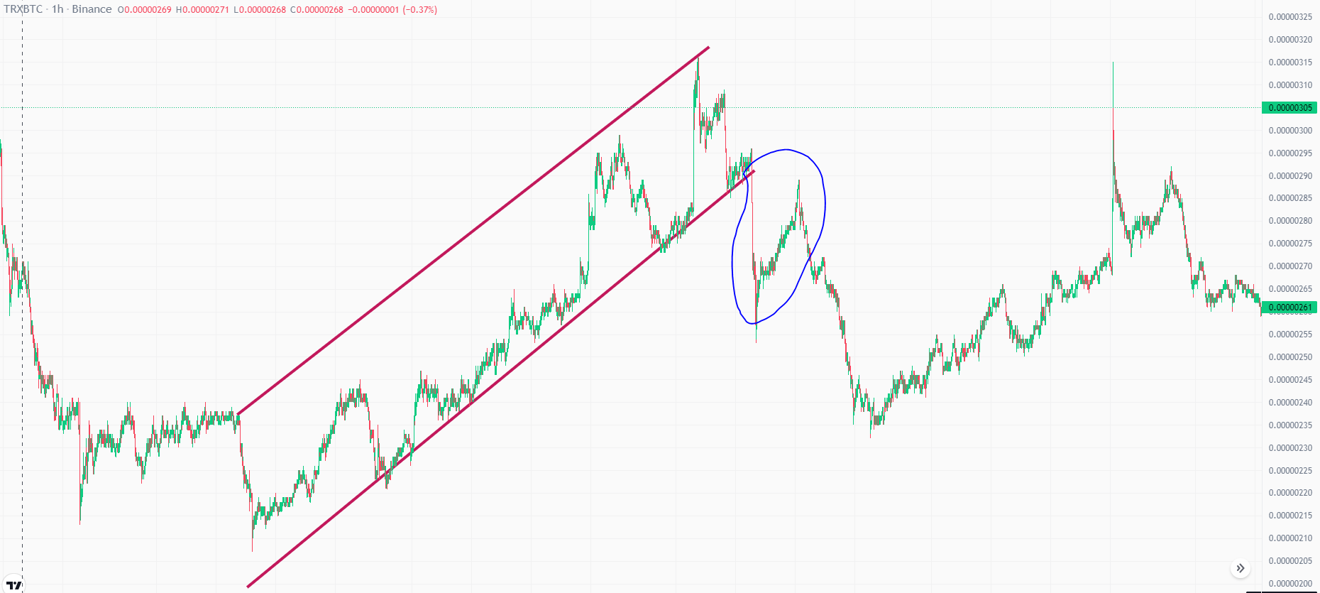
Ascending Channel
Asset revisiting the channel after a breakout.

Slide 8


Slide 9
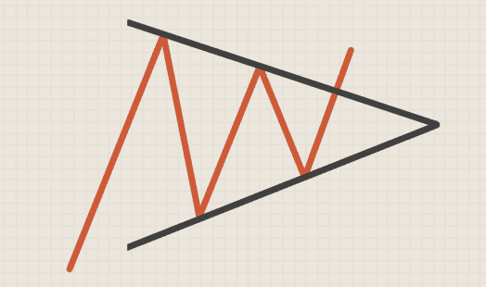
Triangle Patterns
Symmetrical Triangle:
Breakout: Either Way if a symmetrical triangle is formed.
After breakout, Wait for retesting.
Rule of thumb: 3 Candle sticks
Notes:
The market can break out either way if a symmetrical triangle is formed.

Slide 10
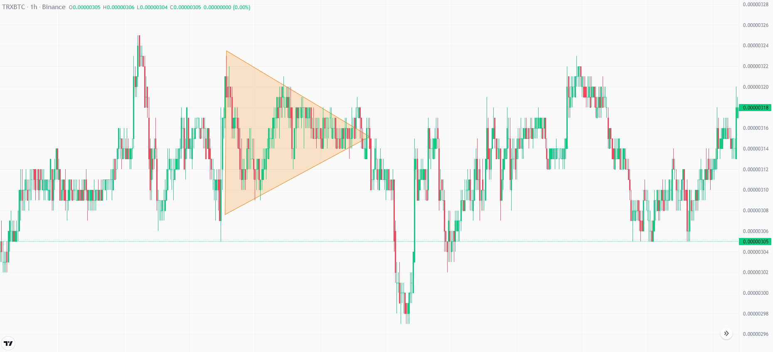
Symmetrical Triangle

Slide 11
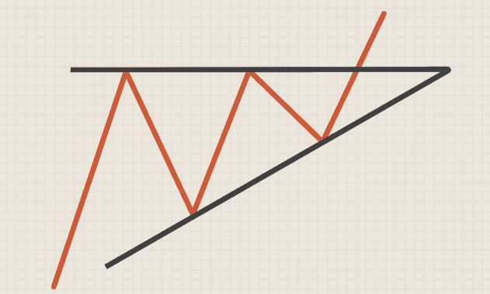
Triangle Patterns
Ascending Triangle:
Breakout: Towards Above.
Remember that after breakout,
Movement of market is FAST
Stop loss is necessary.
Notes:
If the compression is directed from down to up then the market will breakout toward above.

Slide 12
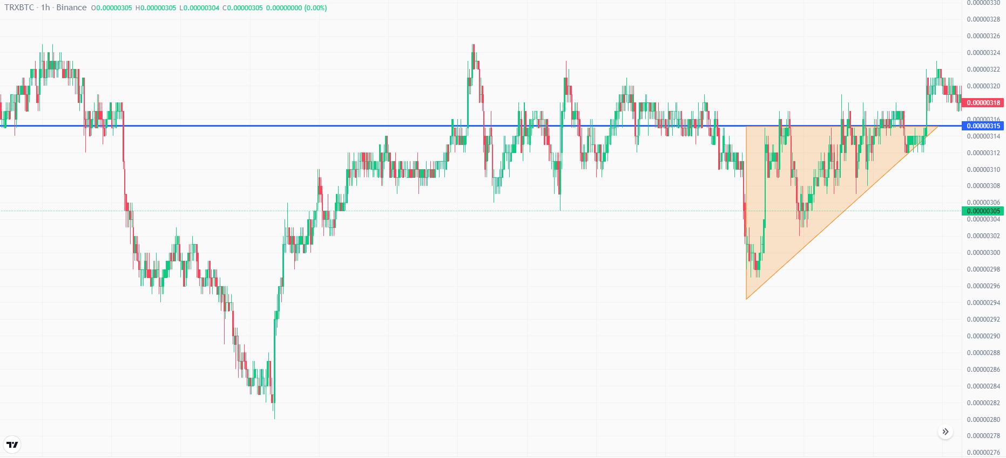
Ascending Triangle

Slide 13
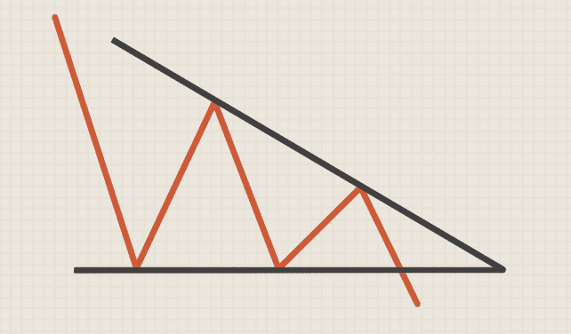
Triangle Patterns
Descending Triangle:
Breakout: A Down Trend

Slide 14
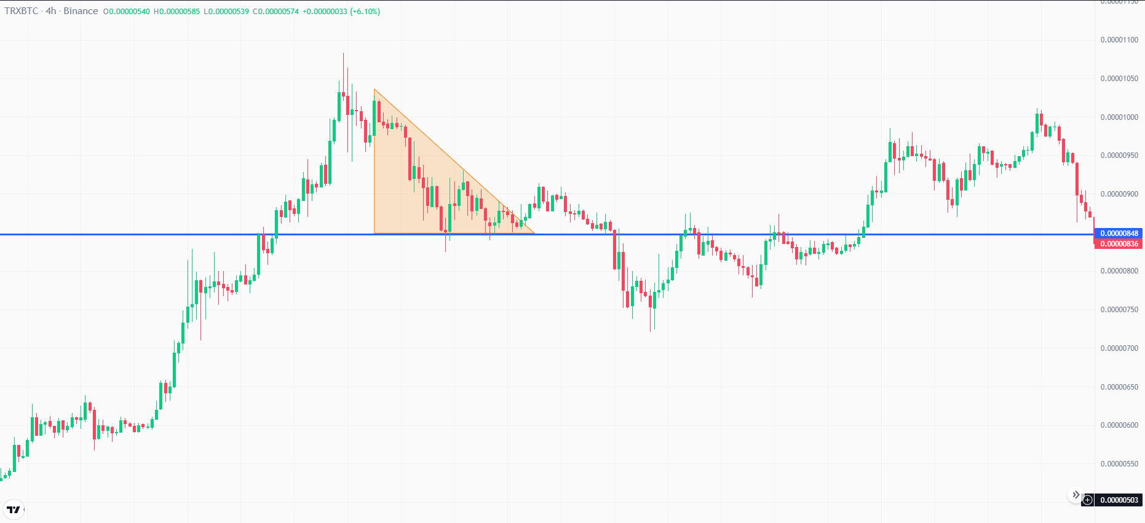
Descending Triangle

Slide 15
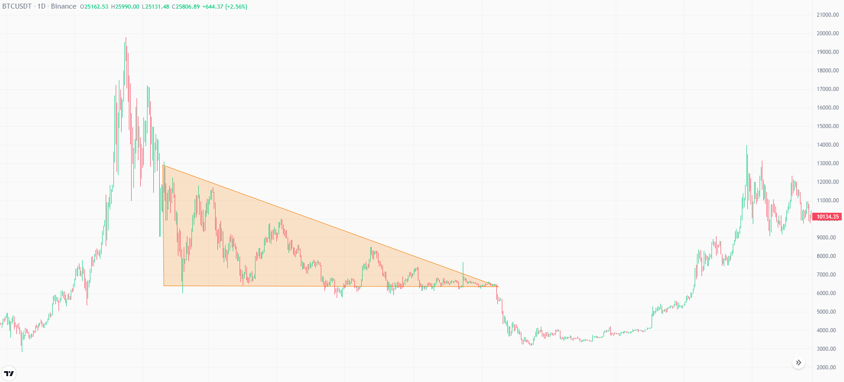
Descending Triangle
A famous descending triangle was made by BTC in 2018.
Which broke out downwards.

Slide 16

Precautions
Wait for Confirmations to avoid Fake Breakouts.
Put Strict Stop Loss.
Look out for Breakout Force and Volume.

Slide 17

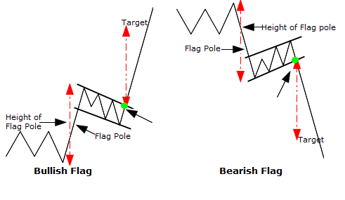
Continuation Patterns
Flag Pole Patterns:

Slide 18
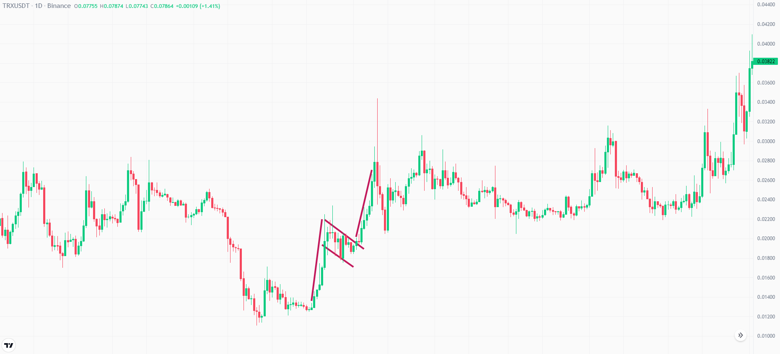
Continuation Patterns
Bullish Flag Pattern

Slide 19
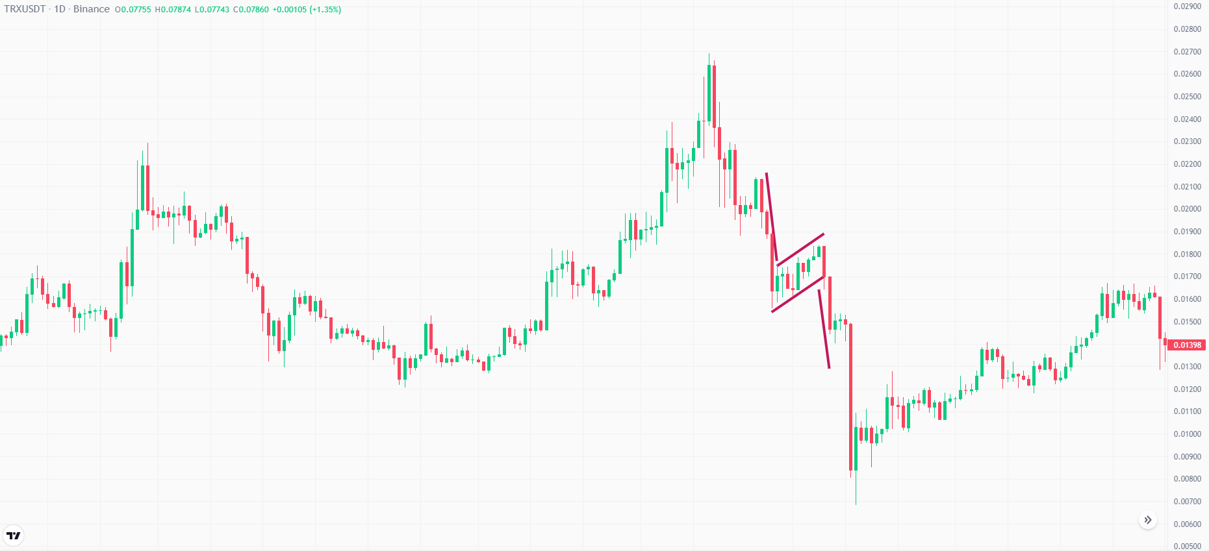
Continuation Patterns
Bearish Flag Pattern

Slide 20
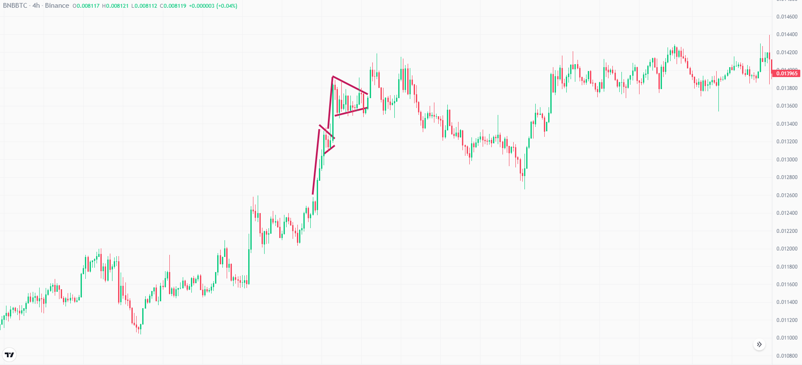
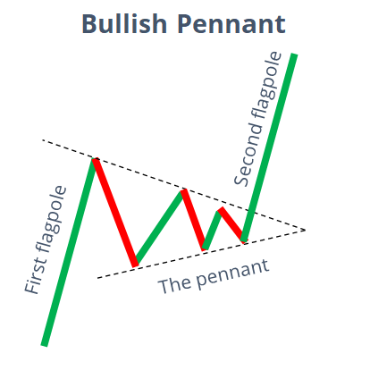
Continuation Patterns
Bullish Pennant Pattern

Slide 21
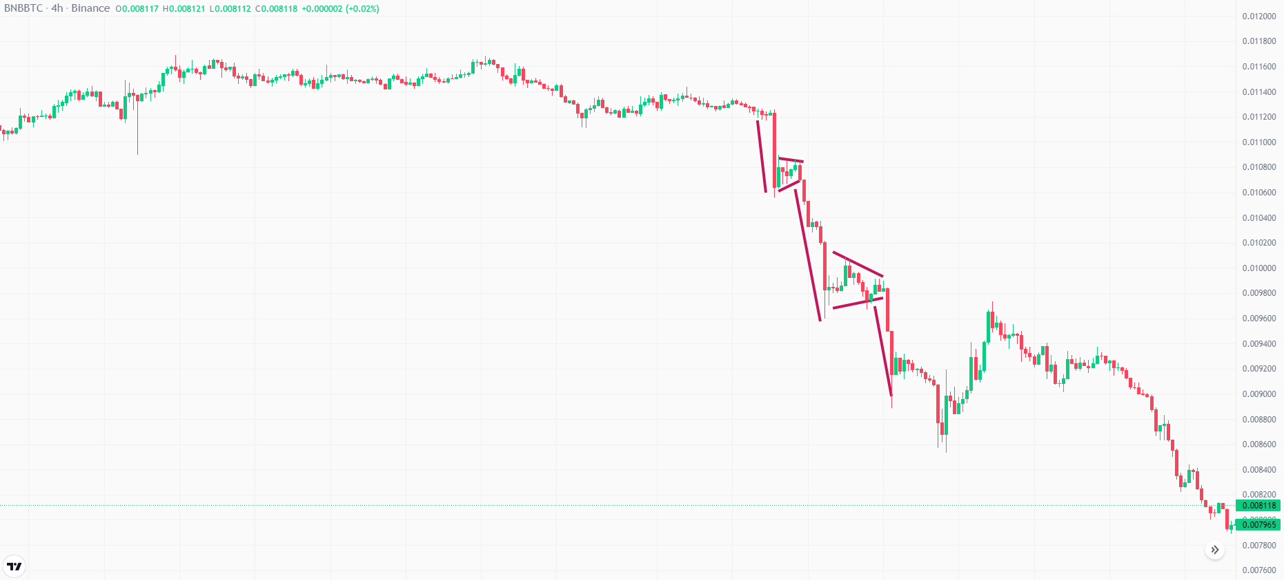
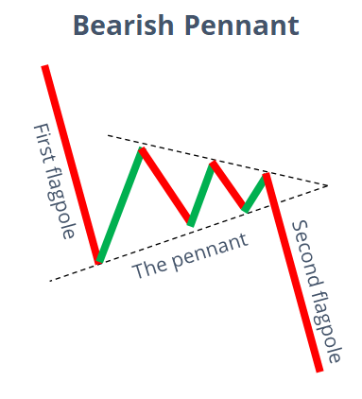
Continuation Patterns
Bearish Pennant Pattern

